Slide 1


Alzheimer Disease Analysis by using RNA Single Transcriptome Data
Supervised By:
Dr/ Mohamed ElHadidi
Dr/ Manar Rashad
By:
Omnia Saeed 18102396
Mennatullah Mahmoud 18101713
Youmna Ramadan 18101142
Menna Abdelsattar 18101590
BMD472: Applied Bioinformatics

Slide 2
Table of contents
01
02
Introduction
Aim of the project
03
04
Methodology
Results

Slide 3

01
Introduction

Slide 4
Introduction
Alzheimer's disease is a progressive neurologic disorder that causes the brain to shrink (atrophy) and brain cells to die.
It is a general term for memory loss and the most common cause of dementia which is a continuous decline in thinking, behavioral and social skills that affects a person's ability to function independently
This disease accounts for 60-80% of dementia cases.

Slide 5
02
Aim of our project

Slide 6
Aim of the project
Accordingly, we need to determine the enriched GO terms between healthy and Late-onset Alzheimer disease (LOAD) in the following transcriptomic single data PRJNA714081.
Mainly the aim of our project is to identify the deferential expression genes (up and down regulation of genes) that compares cases to controls genes using deseq2 , also to determine the functional enrichment analysis that defines the pathways and functions of these genes and which genes from data samples contributed to the pathway leads to the occurrence of the disease.

Slide 7
Gene Ontology
The Gene Ontology (GO) is a major bioinformatics initiative to unify the representation of gene and gene product attributes across all species. It aims to:
1) maintain and develop its controlled vocabulary of gene and gene product attributes
2) annotate genes and gene products, and assimilate and disseminate annotation data.
3) provide tools for easy access to all aspects of the data provided by the project, and to enable functional interpretation of experimental data using the GO, for example via enrichment analysis

Slide 8
03
Methodology

Slide 9
Methodology Steps
01
02
Download Data
Quality Score
03
Pseudoalignment
04
Differential expression analysis
05
Functional enrichment analysis
06
Interpretation analysis

Slide 10
Download Data
From NCBI We choose SRA Database and searched for ALZheimer , then we do some filtrations to choose a project to work on:-
Data Types →Transcriptome
Project Data → SRA
Organism group → Human
The used project contains 15 samples each having 2M reads so we grip only 10000 from each sample

Slide 11
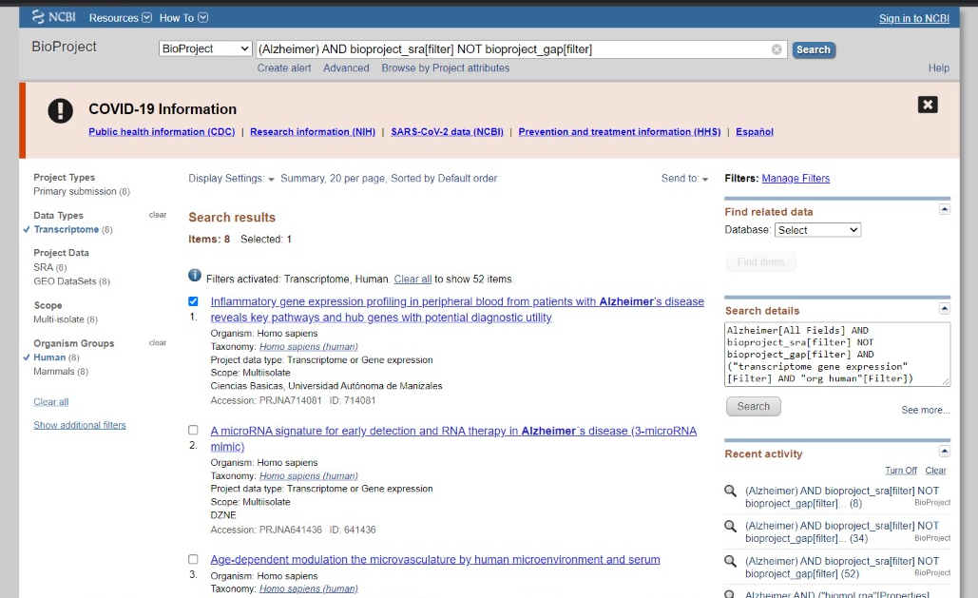
Cont. Download Data

Slide 12
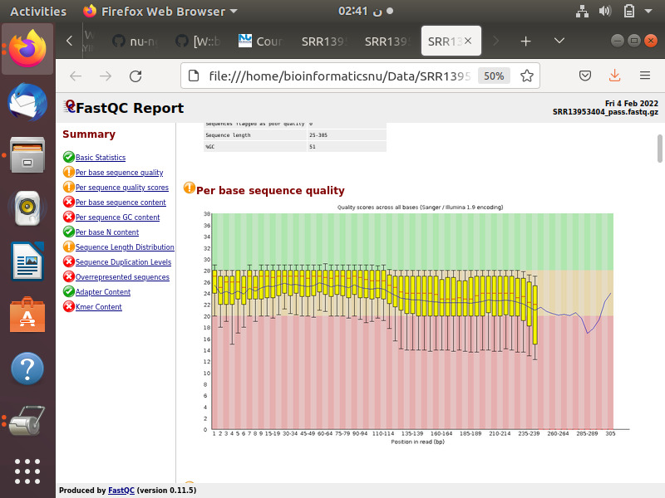
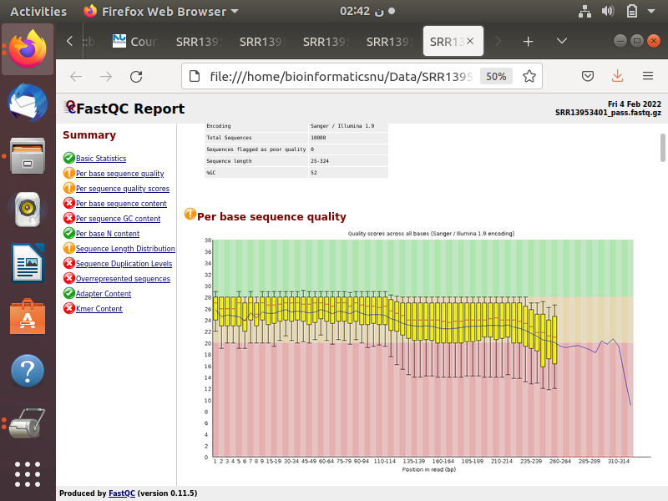
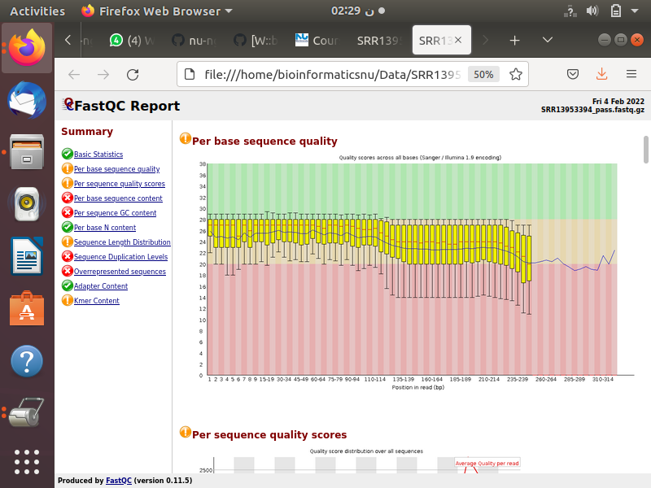
Quality Score
It's clear that the quality score ranges between 20 -28 in most of our data which is a moderate quality score

Slide 13
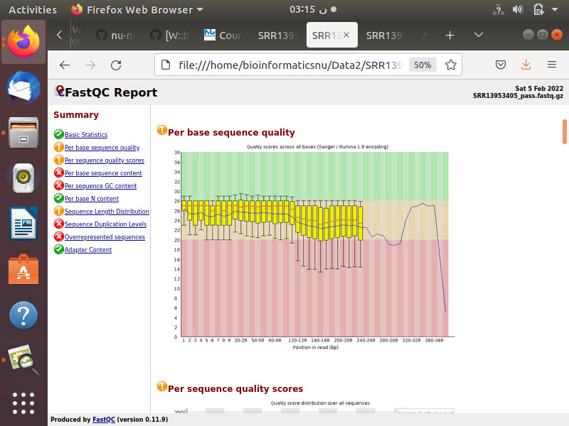
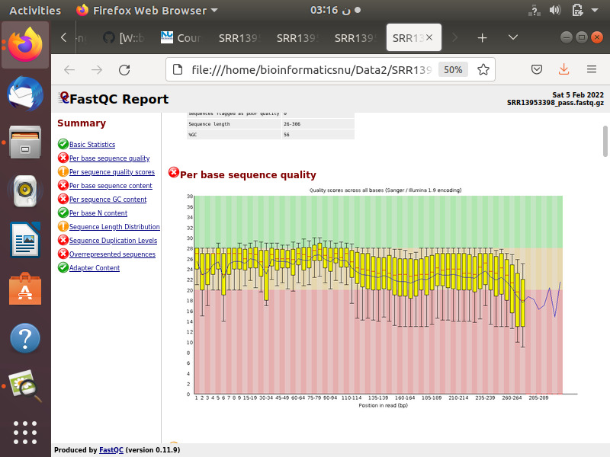
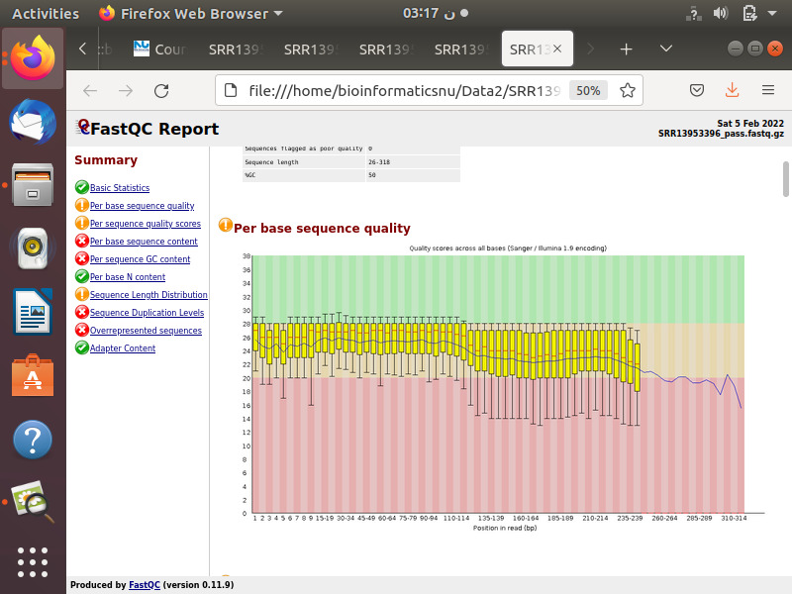
Cont. Quality Score
In order to improve this quality, we have tried to shuffle the data but unfortunately the data didn't change
Thus, We have tried to pick up the reads from the middle between 40000 to 50000 and get Its quality
It seems to get worse as the majority lies between 20-29 and some are below 20

Slide 14
Pseudoalignment
What’s Pseudoalignment ?
It is a rapid k-mer based algorithm that uses a de Bruijn Graph of the reference database to identify potential matches for a query sequence without aligning the query to reference sequences
Pseudoalignment steps:-
Indexing the references into k-mers.
Indexing the reads into k-mers.
Determine which of these references related to this read
Intersect the assigned references.

Slide 15
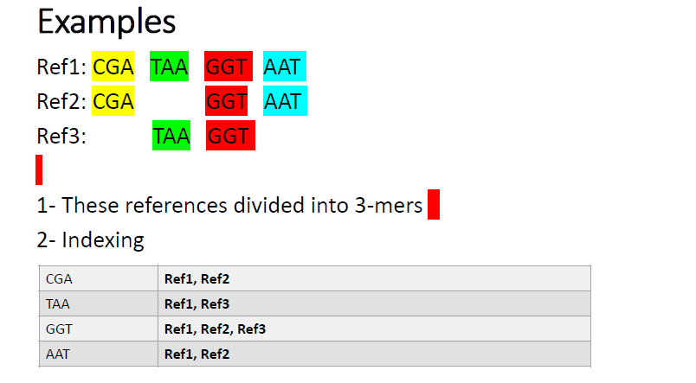
Cont. Pseudoalignment

Slide 16
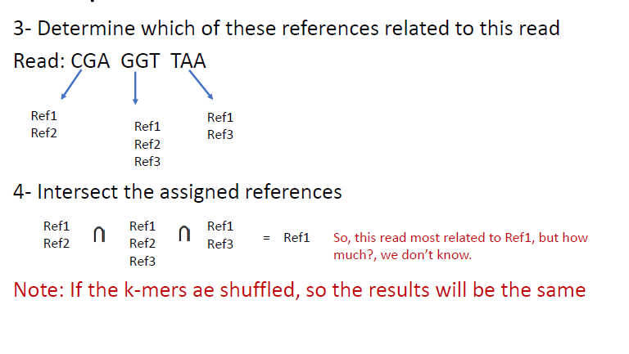
Cont. Pseudoalignment

Slide 17
Cont. Pseudoalignment
What’s Kalisto?
It’s a quick, highly-efficient software for quantifying transcript abundances in an RNA-Seq experiment. Even on a typical laptop, Kallisto can quantify 30 million reads in less than 3 minutes.
Kalisto Inputs :-
We need the FastQ files from the RNA-Seq experiment; we usually start with reads that have already been trimmed/filtered.
We need a reference transcriptome. This is a file that has the sequences for all the known expressed genes.
We need a reference annotations. This is a file that has the names and locations for all the genes in the transcriptome.

Slide 18
Cont. Pseudoalignment
Finally kalisto aligns our reads to the reference.
The output of kalisto :-
We got 4 files as an output to kalisto
Abundance. H5 ,
Abundance.tsv.
Run_info.json.
pseudoalignment.bam
Abundance. H5 is then used in DEseq.

Slide 19
Differential expression analysis
Differential expression analysis means taking the normalized read count data and performing statistical analysis to discover quantitative changes in expression levels between experimental groups, it describes the up and down regulations of genes by statistical analysis to compare cases to controls.
there are different methods for differential expression analysis such as edgeR and DESeq. In our project, we used DESeq.

Slide 20
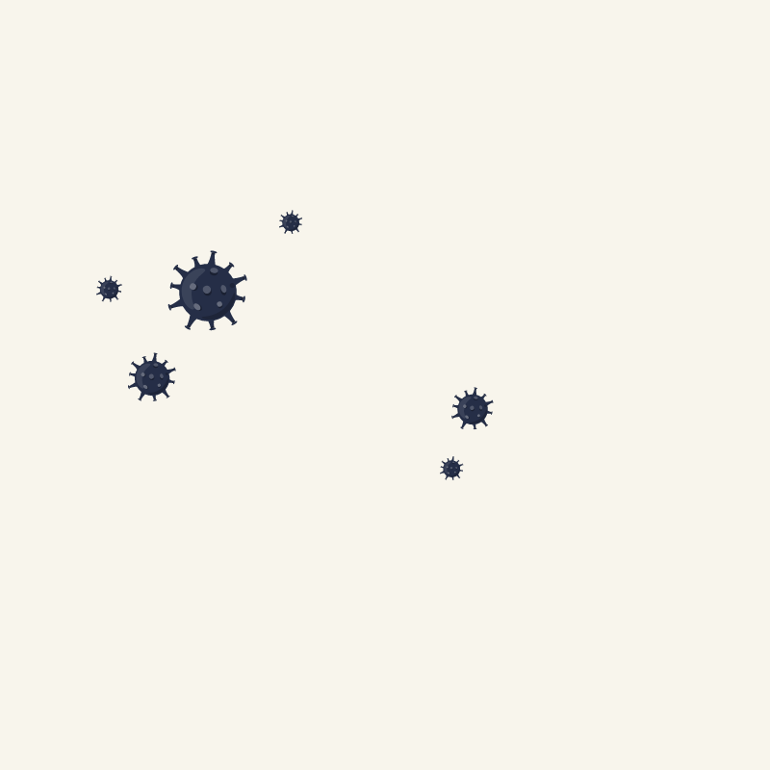
First download libraries using for deseq2 then import them.
Second create list of files then pick up files ended by .h5 from my samples of kallisto results then modify their header names files to appear the transcripts to be easily enter to deseq function and download the metadata of my samples:
Third change the names of filh5 files’ names to their bio samples names then using the outputs of the kallisto to input for deseq2 by tximport library, then put the outputs exits to deseq2 library functions, in deseq2 and compare between two conditions (“healthy” & “Late-onset Alzheimer disease (LOAD)”) .

Slide 21
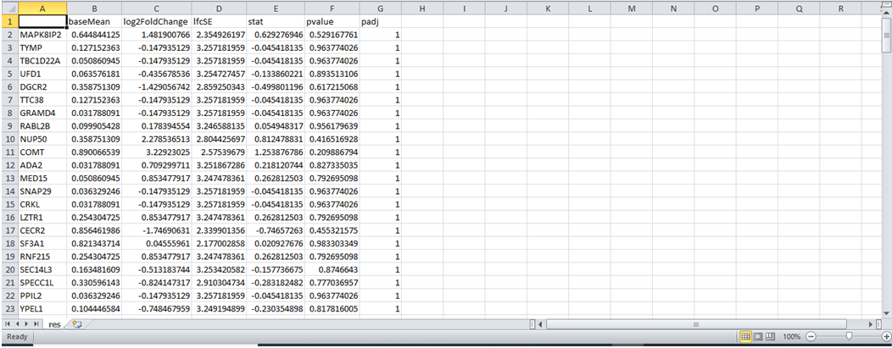
Deseq2 output

Slide 22
Functional enrichment analysis
functional enrichment analysis defines the pathways and functions of these genes and which genes from data samples contributed to the pathway leads to the occurrence of Alzaheimer’s disease.
functional enrichment analysis is to compare the enrichment of any type of biologically relevant labels such as gene ontology terms in these genes to that in the background. Hypergeometric distribution or binomial distribution is usually applied to give the p-value for whether the enrichment is significantly different in the given gene cluster and in the background

Slide 23
in David functional enrichment analysis:
a) Make start analysis then take a copy of genes.
a) Choose official gene symbol.
b) Homosapiens.
c) Gene list.
d) Then submit file
f) Choose functional annotation chart
g) Download KEGG_pathways chart

Slide 24
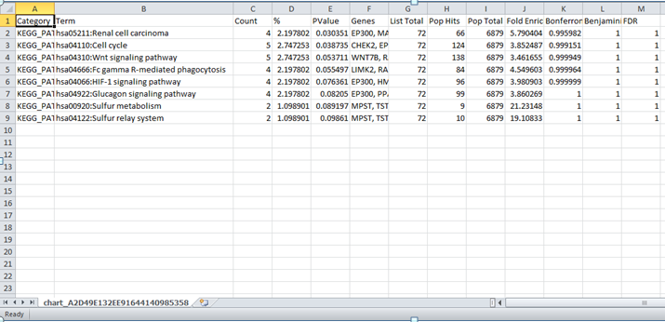
David output

Slide 25

GOPlot

Slide 26
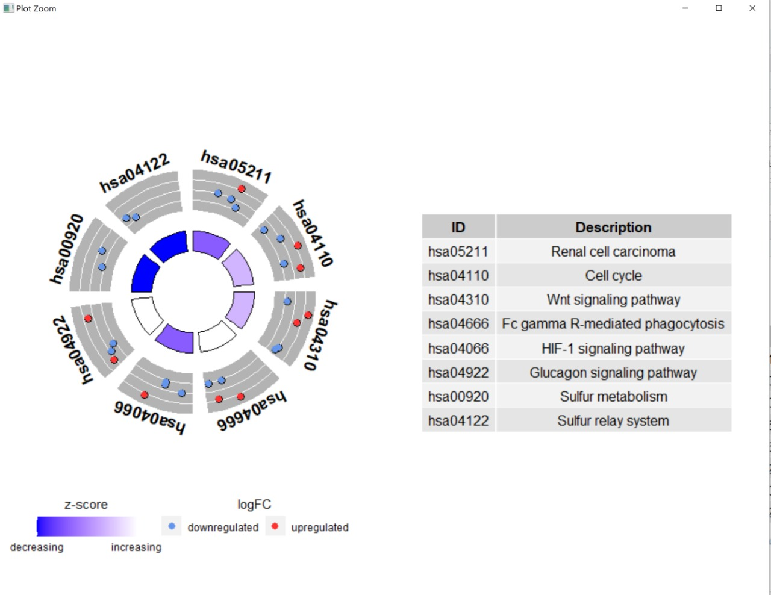

Slide 27
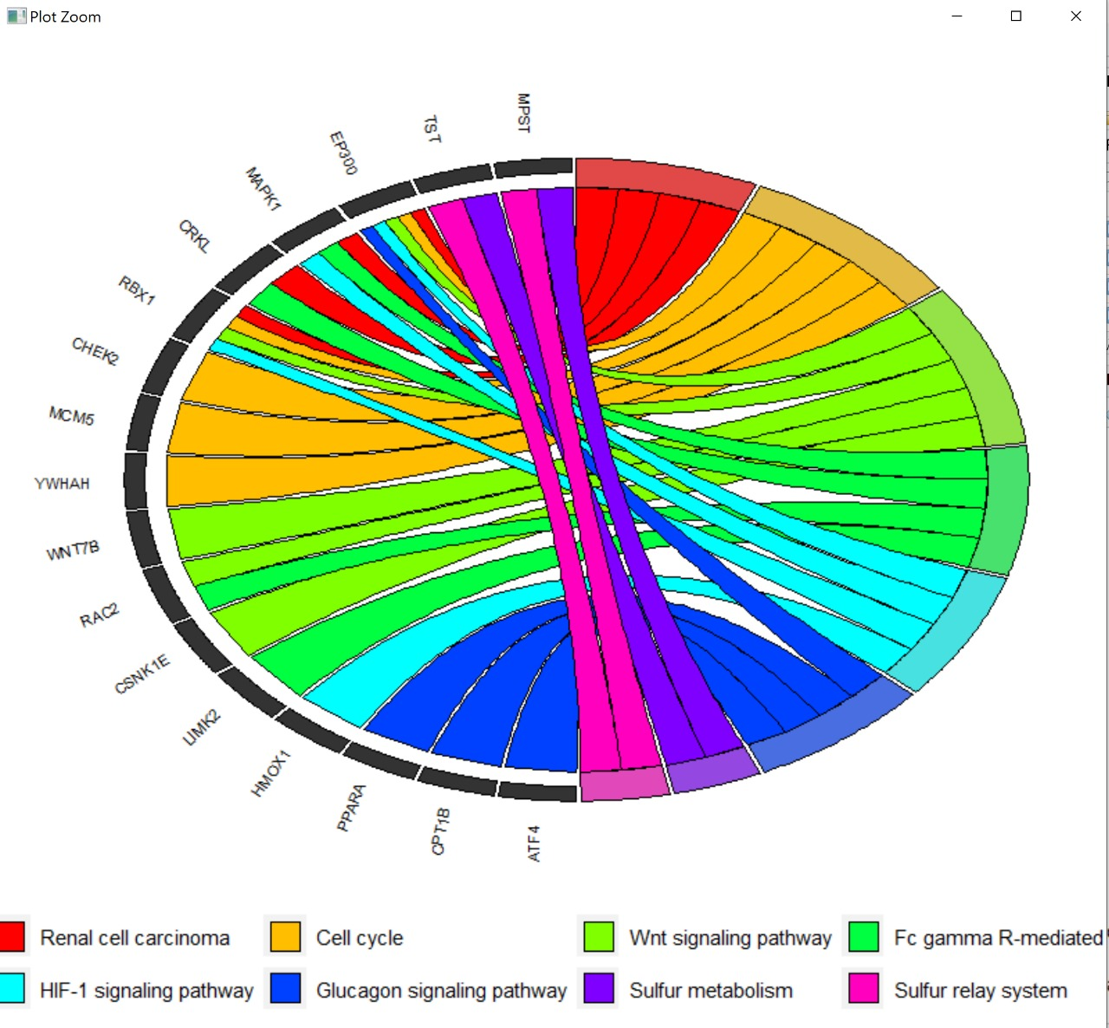

Slide 28
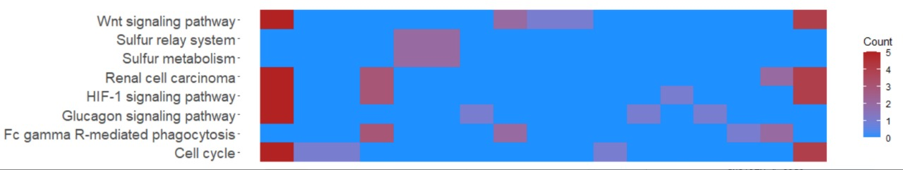

Slide 29
Interpretation analysis

Slide 30
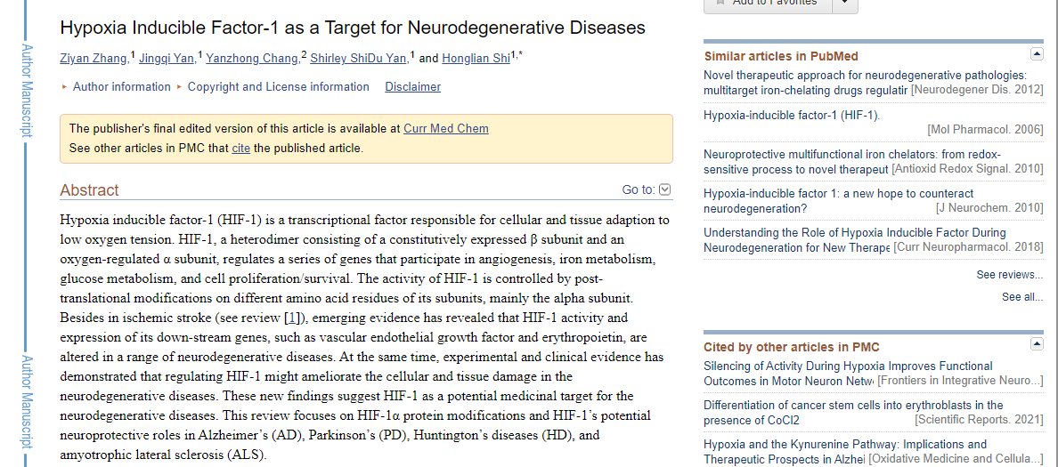

Slide 31
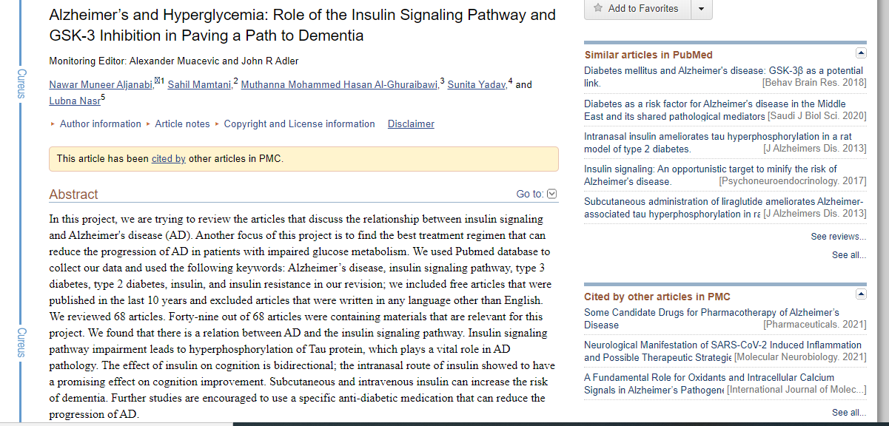

Slide 32
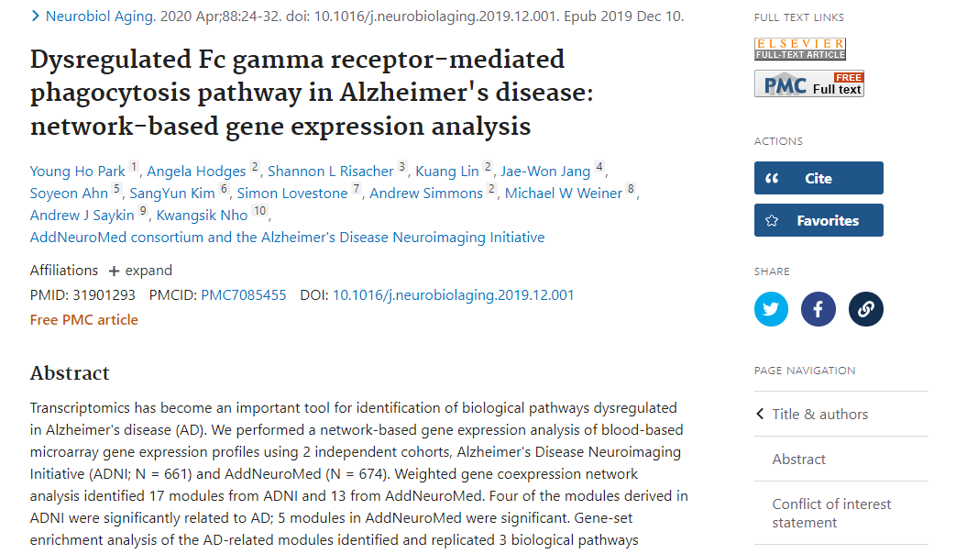

Slide 33
Bash Script

Slide 34
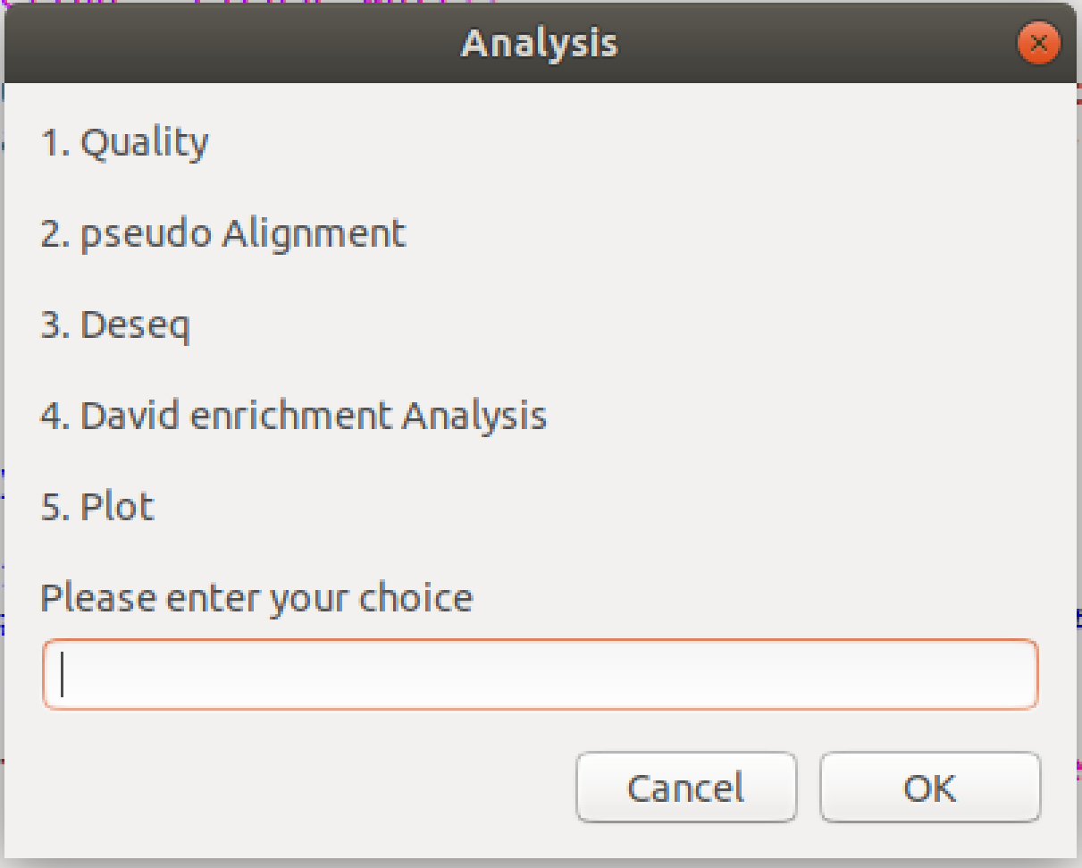
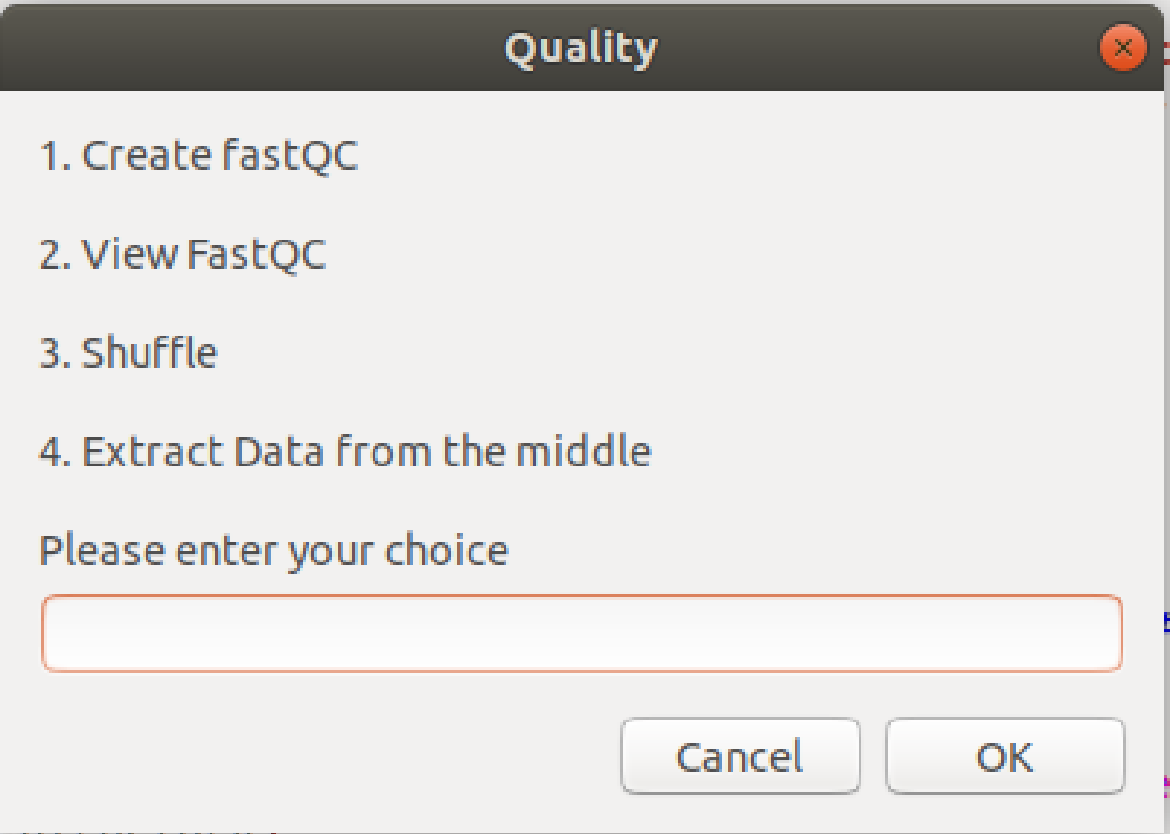

Slide 35
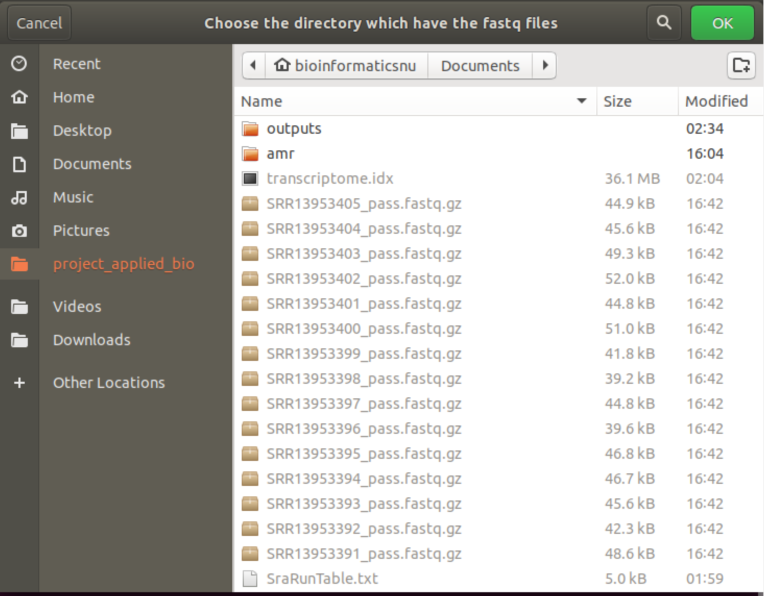
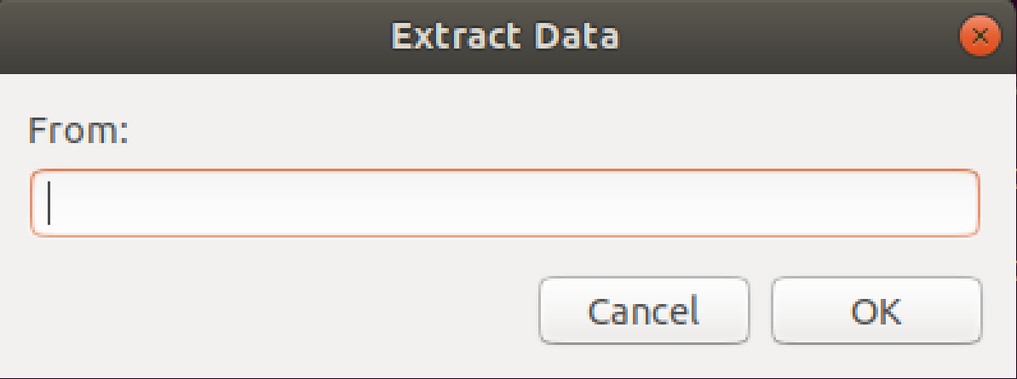
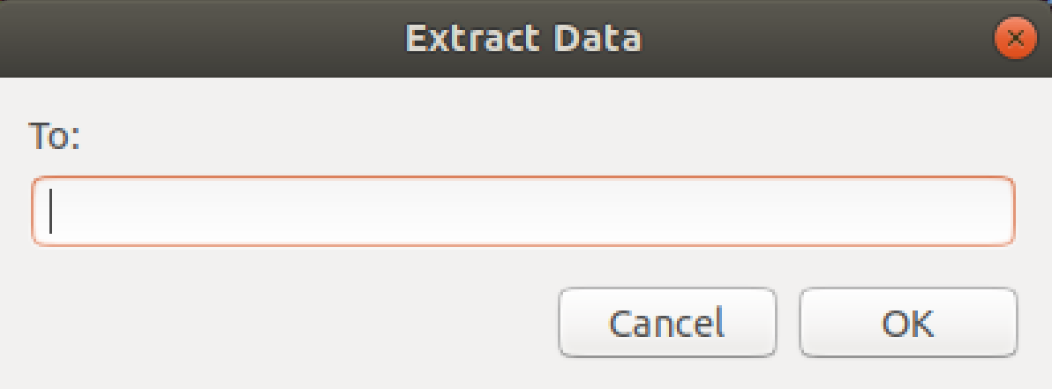

Slide 36
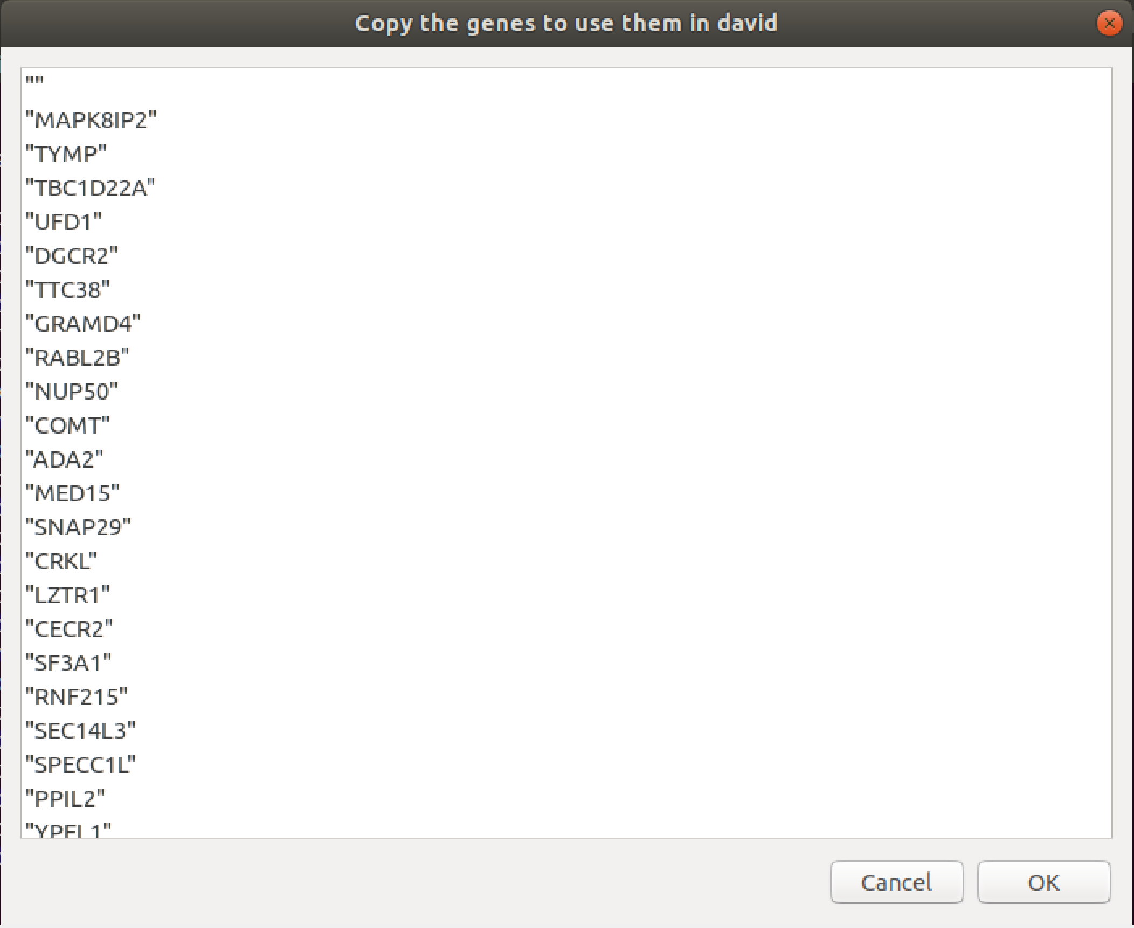
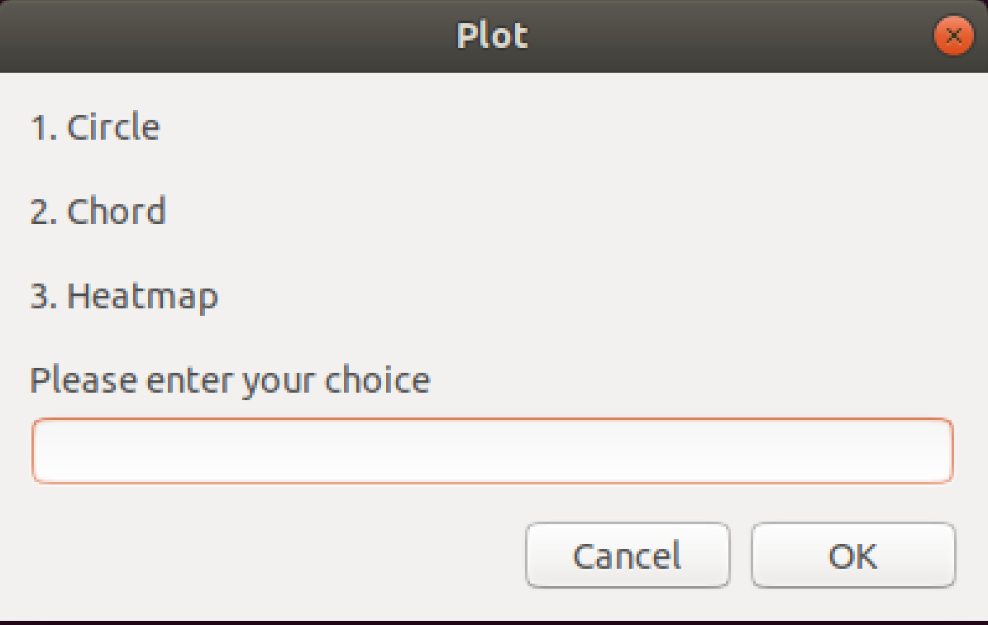

Slide 37

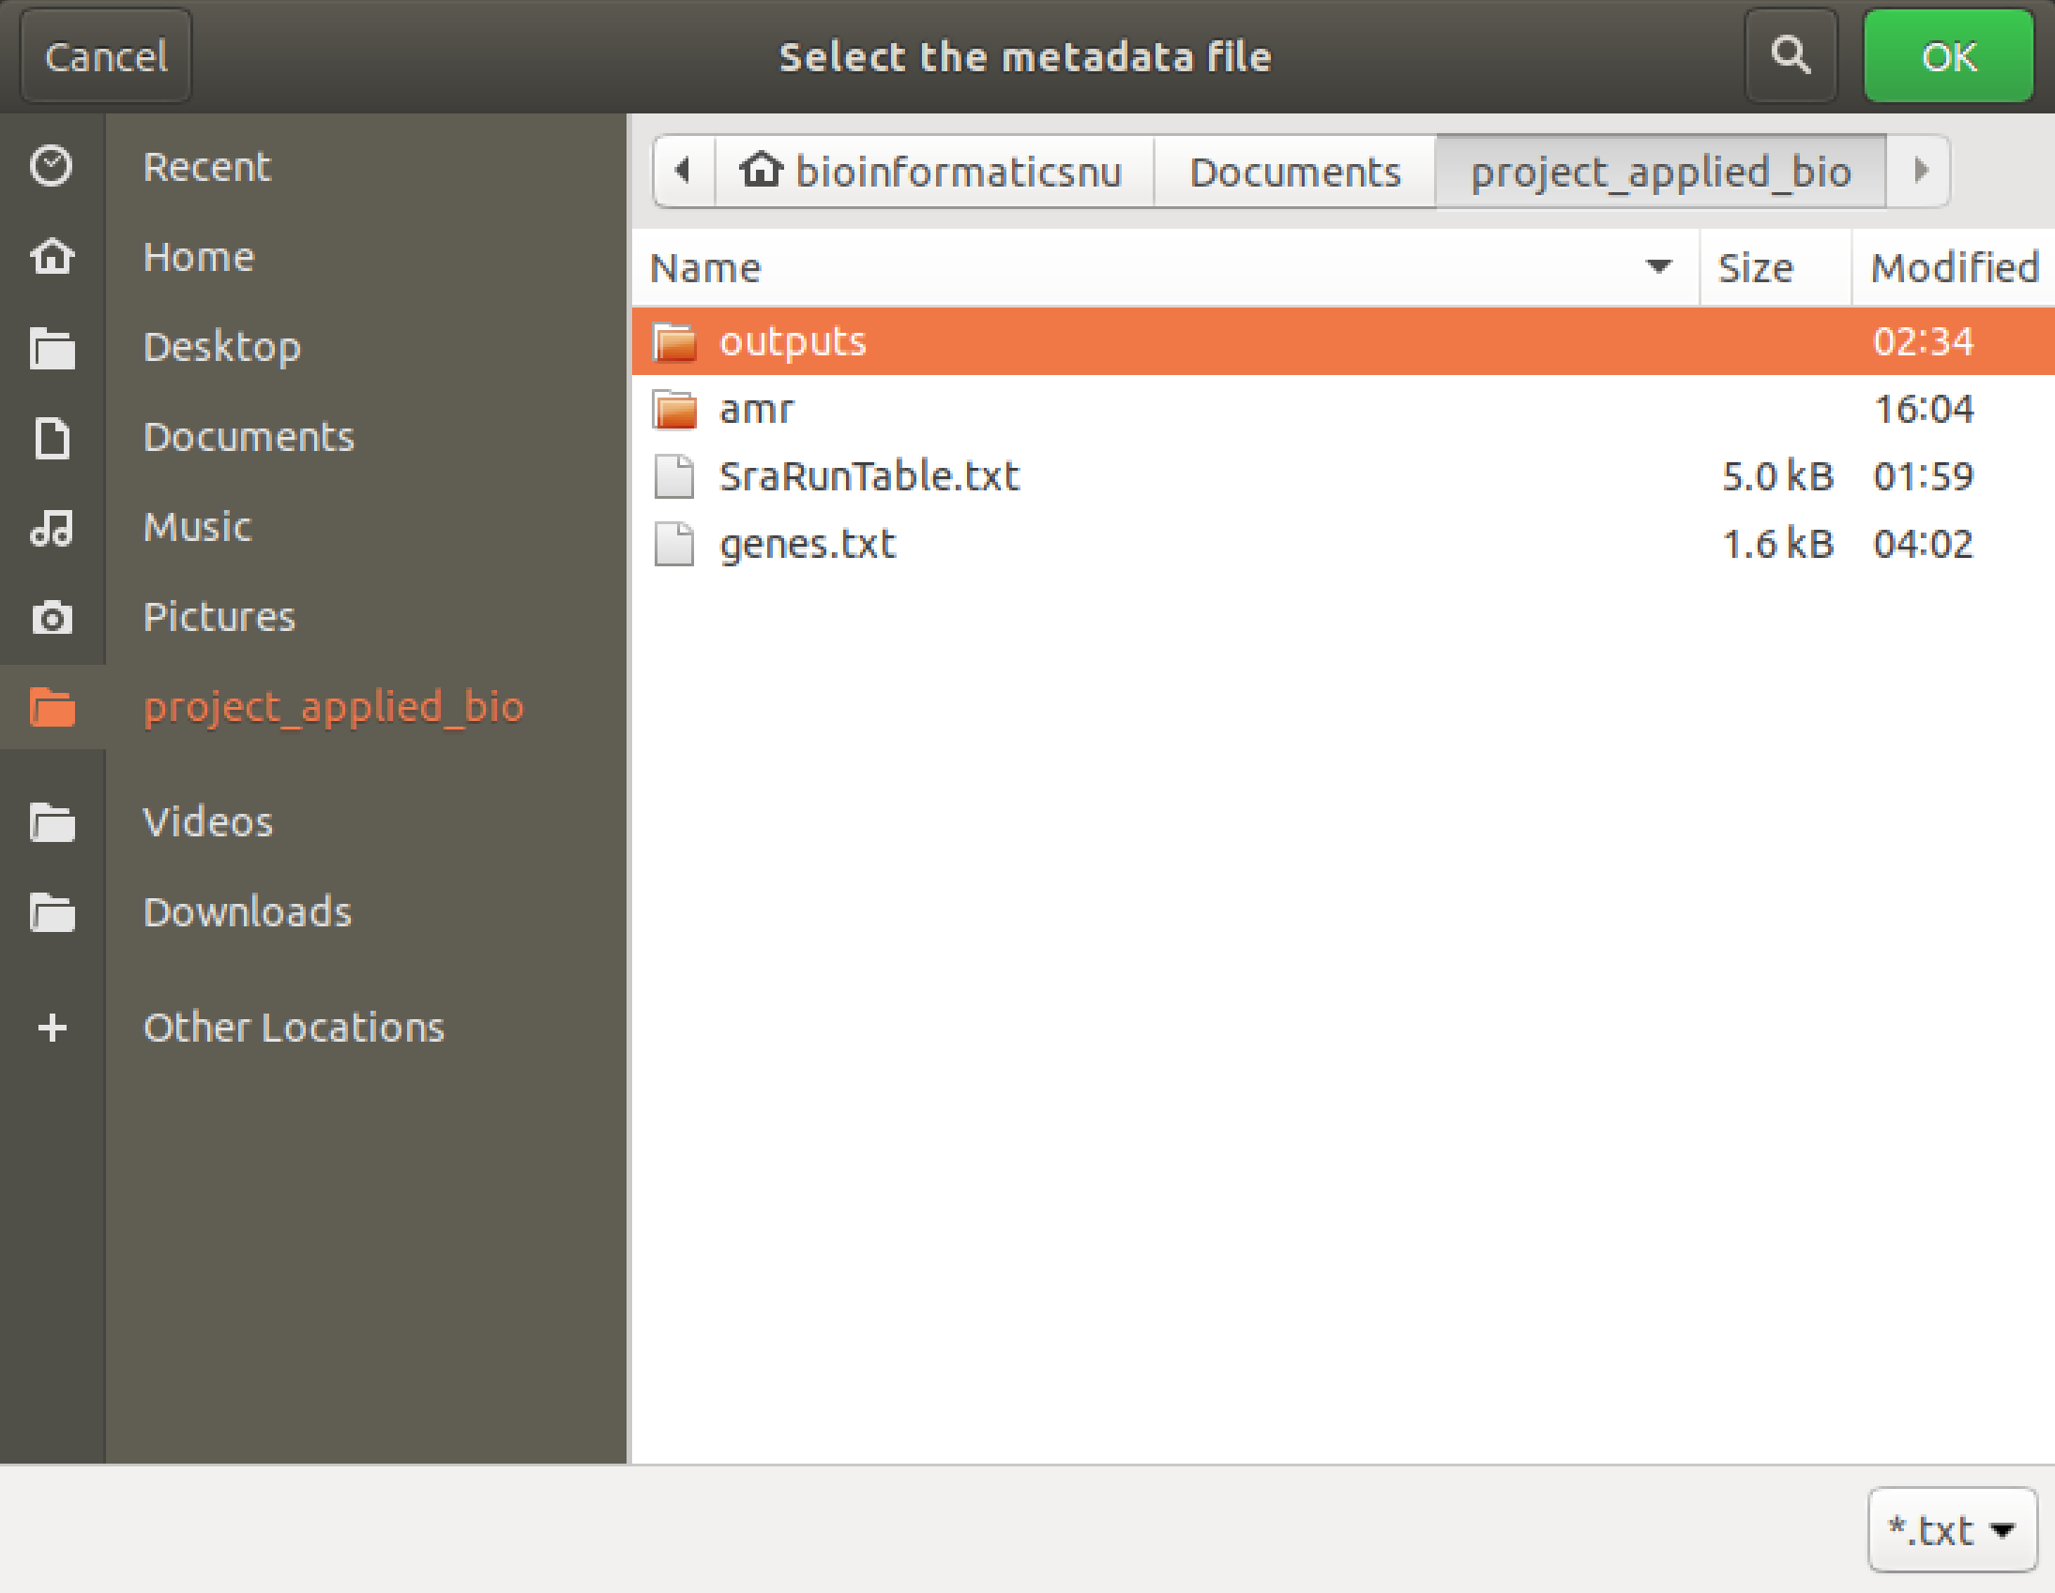
Validation

